Slide 1
Software Architecture Assignment :1
BITS Pilani
Name | Email Address | ID Number
Aiman Kamal | 2021mt12160@wilp.bits-pilani.ac.in | 2021mt12160

Slide 2
Purpose of the system
CFME - CloudForms is a Red Hat product that the Labs have adopted in order to provide a menu of services (particularly virtual machines) to be ordered. It is the replacement for Omnitool (cxlabs.cisco.com) for virtual machine access, creation, and management.
CFME is an application worked on CloudForm technology. It is a management platform for internal Cisco where its managing traditional server virtualization products such as VMware vSphere.
Here, Support for the local site infrastructure is provided by the local Labs team in your location. Based on local sites and its servers, CFME having as of now 11 different management tool where 1 among it is development tool which managing all other 10 tools.

Slide 3
Key Requirements : Functional & Non-Functional
Functional requirements | Non functional requirements
Customer , Subscriber and Account Management Basic Rating Notification over tool Outlook mail Rating VM and its template Details Records Fundamental Package configuration Open API integration capability | Operation and Maintenance Backup of records Security and its ACL Automation Advancement and its Scaling

Slide 4
Utility Tree
Understanding business value & Impact on architecture
Quality attribute | Attribute Refinement | Scenario | Business Value | Architecture Impact
Security | Integrity | The data should not be lost or tampered with by unauthorized people, including those working in the company (1) | High | High
Performance | Service Availability | System should support 99.999% Availability (5) | High | High
Usability | User Experience | Customer under TACACS+ should be able to login using system UI using standard self guided workflow within 2 minutes, (3) | High | High
Usability | Correctness | System should provide limited VMs to customer accurately based on Global policy. | High | High
Modifiability | Criteria specification | User should be able to modify VM and its template using system feature. (4) | High | High
Interoperability | Notification | The system should send real time notification to the customer when he/she order a new Virtual machine or for any modification to it. (5) | High | Medium
Performance | Response time | System should be able to support 1000 CAPS. | Medium | High
Interoperability | Unified User Experience | Customer should be able to get a personal space for deployment of VM on single platform each URL/site | High | High
Usability | Understanding user model | Customer should be able to query his/her machine record, system should store & support the query of minimum 6 months, query response should be less than 5 seconds.(2) | Medium | Low
Usability | Intuitiveness | Using Data service should be very easy (2) | High | Medium
Interoperability | User Experience | Customer should be able to use basic services and Record, Virtual Machine deployment Should not take time more then 30 minutes | High | High
Usability | Understanding user Model | Customer should be able to choose machine feature and resource, Can raise the concern/feedback using another tool | High | Low
Usability | Status notification | Customer should be notified when VM is activated, or failed | High | Medium
Performance | Scalability | System should support Millions of VMs deployment for any kind of ISO/OVF | High | High

Slide 5
Utility Tree
Understanding business value & Impact on architecture
Quality Attribute | Attribute refinement | Scenrario | Business value | Architecture Impact
Maintainability | Easy Operation & Maintenance | System should support easy monitoring, alarms , deployment. | High | High
Security | Confidentiality | Customer personal data like email/password ..etc should be encrypted in database using standard algorithm(5) | High | Medium
Availability | Data backup | System should keep back up of complete system data including customer information , system configuration details, (3) | Medium | High
Testability | Detecting failure modes | System should support auto/mock testing to reduces testing cost and efforts. (4) | Medium | Low
Availability | Data backup | Solution supports databases and virtualization environments full backup or Differential incremental backup | High | Medium
Security | Operation & Maintenance | Manage and audit all system logs through a centralized log server | Medium | High
Security | Operation & Maintenance | Monitor all systems to find exceptions and attacks | Medium | High
Performance | Scalability | System should be able to Scale In/Out based on future business need. | Medium | High

Slide 6
Tactics used to achieve the top 3 ASRs : Security
Quality Attribute | Scenario (ASR) | Tactics
Security | The customer data should not be lost or tampered with by unauthorized people, including those working in the company (1) | No direct access database by any user, all system user can access backend data through system business process with respective access rights.
 |  | Web Service Interfaces will be authenticated with User/Password
 |  | Coding security includes security methods during programming of codes
 |  | Access security includes identification, authentication, authorization, access control, session control etc.
 |  | Block multi session login from different devices and session time out after 5 minute (default time) for system user.
 |  | Store data on a separate database server cluster and protect the server using an appropriate security zones using firewall technologies
 | Customer personal data like email/password/VMs should be encrypted in database using standard algorithm(5) | Encrypt critical and personal data using standard protocol Like DB user Password will be encrypted using TACACS+, sensitive data of application like password AES 128 algorithm for encryption
 | Manage and audit all system logs through a centralized log server | Develop a centralized log monitoring module to audit the system, user logs.
 | Monitor all systems to find exceptions and attacks. | Communication security is to ensure the security of transmission through secure protocol and non-repudiation technologies like HTTPS/SSL.
 |  | Ensure the security of applications and database OS
 |  | Separate different network traffic and control through the appropriate security zones depending on subnets and firewall technologies
 |  | Protect internal and external network connections through VPN tunnels
 |  | Develop a centralized log monitoring module to audit the system, user logs

Slide 7
Tactics used to achieve the top 3 ASRs : Performance
Quality Attribute | Scenario (ASR) | Tactics
Performance & Scalability | The system should send real time notification to the customer when he/she order new VM or feature modification | Design south bound integration using Elastic Load Balancer 99.999% Availability based on Distributed Architecture.
 | System should be able to support 1000 request per minute by multiple Engineers | New Services Deployed as Add-ons in separate container using service based architecture (SBA)
 | System should support Millions of Request either new deployment or modification in services. | Session Control and Routing Service Separated from Session Control and Routing Database Cluster All Routing Service Nodes and Routing In-memory Database Nodes are Active Distributed DB and In-Memory DB Improve X Capacity and Performance
 | System should be able to Scale In/Out based on future business need within 1 day. | Fully Micro-service Based Architecture to support Auto service Scaling In/Out. Container: support seconds Scale In/Out, 90% Computing/hardware Resource savings for individual

Slide 8
Tactics used to achieve the top 3 ASRs : Interoperability
Quality Attribute | Scenario (ASR) | Tactics
 | The system should send real time | Develop SMS adapter so user can get related messages over phones as well.
 | notification to the customer when he/she
 | Order a VM
Interoperab ility | Customer should be able to use basic services from different network by having VPN connected. VM deployment delay should be more than 30 minutes. VM feature modification should take maximum 60 seconds. | Develop separate module for storage and functionality using service container.
 | System should be able to support | Develop API gateway for Deployment enhancement
 | Multiple OS on single platform

Slide 9
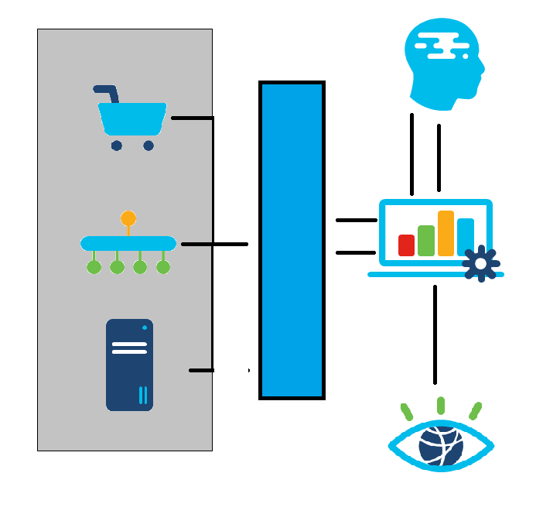
System Context Diagram
User
Storage
Network
Compute
TACACS+
API System
CFME
Monitoring System
ESXI (Hypervisor) on top UCS

Slide 10


Module Decomposition Diagram
Legends
CFME Engine
DB: Database
Storage
Network
CPU
Storage Adapter
Network Adapter
Data Access Layer
Network Layer
Select From Available Network
Virtualized CPU
External DB
Physical DB
…

Slide 11
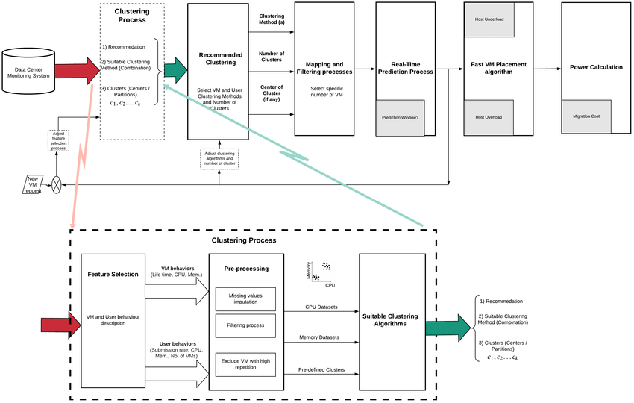
Component & Connection diagram

Slide 12
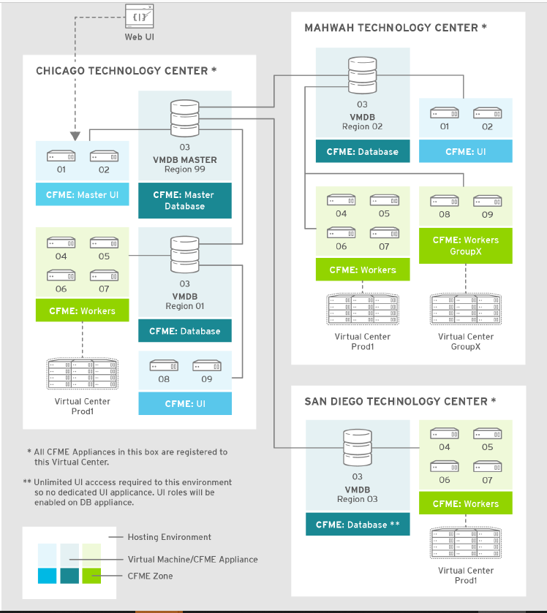
Deployment diagram

Slide 13
CFME Works
CFME handle conventional virtualization application products such as VMware vSphere
CFME Communicates to vSphere with the help of CFME engine.
CFME validates and authenticate the correct user in the domain using TACACS or Radius.
Once user request a service on CFME, CFME engine pass down the user instruction to vSphere to create, delete or modify the virtual machine.
CFME keeps track of the request made by the user, on successful completion of the request, users are notified on CFME and also via email.
CFME also returns various error based on the underline virtual infrastructure, when the user request fails.
If virtual infrastructure is not working properly, CFME would also state the error related to the virtual infrastructure status.

Slide 14
Top 3 Key Learnings on CFME
• Provisioning or scaling out of workloads, such as virtual machines or cloud
instances
• Provisioning or scaling out of infrastructure, such as bare-metal hypervisors or
compute nodes
• Scaling back or retirement of virtual machine or cloud instances
Each of these is done in the context of comprehensive role-based access control.

